Slide 1
View 변환 행렬

Slide 2
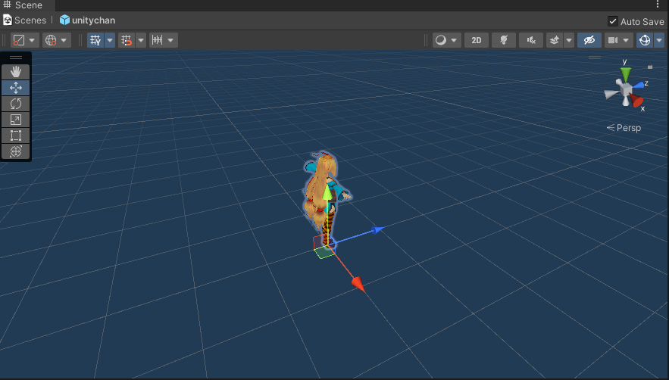
Local space
Up
Look
Right

Slide 3
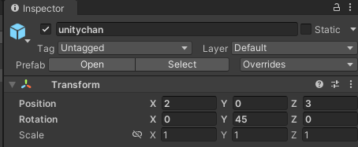
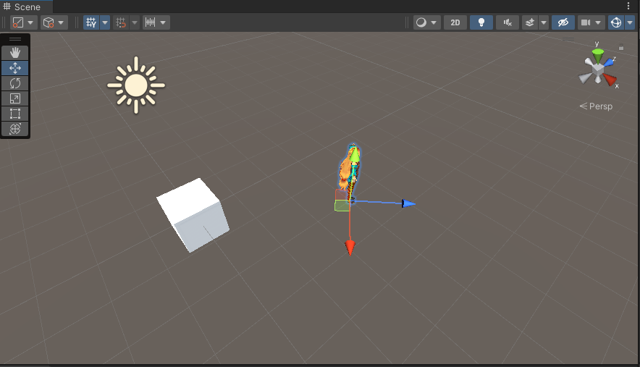
world space
Up
Look
3
2
Right

Slide 4
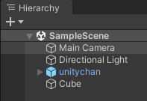
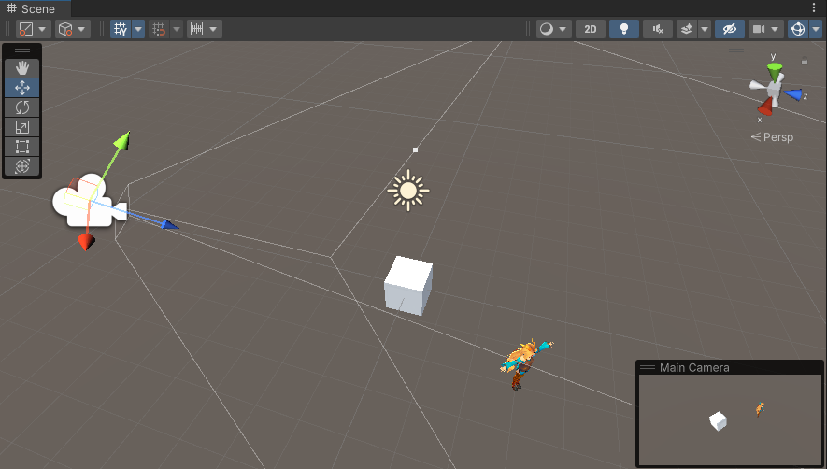
view (camera, eye) space

Slide 5
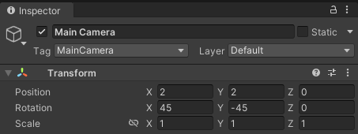



view matrix
$$V$$
$$V^{−1}$$

Slide 6
$$\vec{V}$$
$$\vec{U}$$
$$B$$
$$\vec{v}$$
$$A$$
$$\vec{u}$$
(B 좌표계 기준) $\vec{u}$, $\vec{v}$, $\vec{w}의$ 성분
M = $\left[\begin{matrix}\begin{matrix}u_{x} & u_{y} \\ v_{x} & v_{y}\end{matrix} & \begin{matrix}u_{z} & 0 \\ v_{z} & 0\end{matrix} \\ \begin{matrix}w_{x} & w_{y} \\ Q_{x} & Q_{y}\end{matrix} & \begin{matrix}w_{z} & 0 \\ Q_{z} & 1\end{matrix}\end{matrix}\right]$
$$\vec{v}=\left[\begin{matrix}\begin{matrix}x & y & z\end{matrix} & 1\end{matrix}\right]$$
(B 좌표계 기준) A의 좌표
$$\vec{V}=\left[\begin{matrix}\begin{matrix}X & Y & Z\end{matrix} & 1\end{matrix}\right]$$

Slide 7
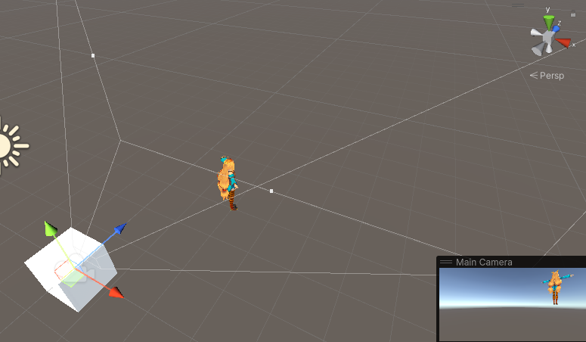
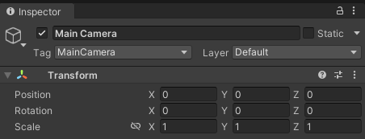
$$\vec{u}$$
(B 좌표계 기준) $\vec{u}$, $\vec{v}$, $\vec{w}의$ 성분
M = $\left[\begin{matrix}\begin{matrix}u_{x} & u_{y} \\ v_{x} & v_{y}\end{matrix} & \begin{matrix}u_{z} & 0 \\ v_{z} & 0\end{matrix} \\ \begin{matrix}w_{x} & w_{y} \\ Q_{x} & Q_{y}\end{matrix} & \begin{matrix}w_{z} & 0 \\ Q_{z} & 1\end{matrix}\end{matrix}\right]$
$$\vec{v}=\left[\begin{matrix}\begin{matrix}x & y & z\end{matrix} & 1\end{matrix}\right]$$
(B 좌표계 기준) A의 좌표
$$\vec{V}=\left[\begin{matrix}\begin{matrix}X & Y & Z\end{matrix} & 1\end{matrix}\right]$$

Slide 8

$$\vec{u}$$
(B 좌표계 기준) $\vec{u}$, $\vec{v}$, $\vec{w}의$ 성분
M = $\left[\begin{matrix}\begin{matrix}1 & 0 \\ 0 & 1\end{matrix} & \begin{matrix}0 & 0 \\ 0 & 0\end{matrix} \\ \begin{matrix}0 & 0 \\ 0 & 0\end{matrix} & \begin{matrix}1 & 0 \\ 0 & 1\end{matrix}\end{matrix}\right]$
$$\vec{v}=\left[\begin{matrix}\begin{matrix}x & y & z\end{matrix} & 1\end{matrix}\right]$$
(B 좌표계 기준) A의 좌표
$$\vec{V}=\left[\begin{matrix}\begin{matrix}X & Y & Z\end{matrix} & 1\end{matrix}\right]$$

Slide 9
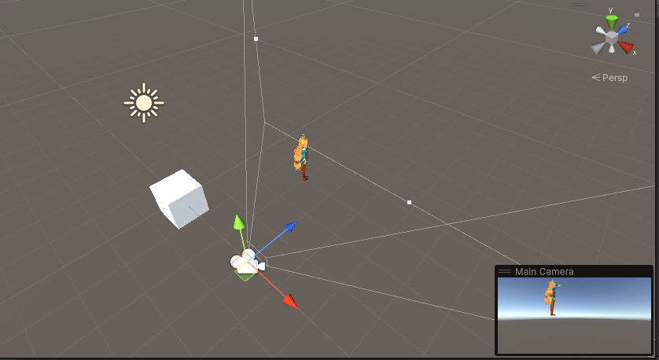
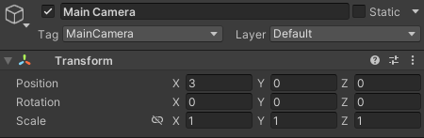
$$\vec{u}$$
(B 좌표계 기준) $\vec{u}$, $\vec{v}$, $\vec{w}의$ 성분
M = $\left[\begin{matrix}\begin{matrix}u_{x} & u_{y} \\ v_{x} & v_{y}\end{matrix} & \begin{matrix}u_{z} & 0 \\ v_{z} & 0\end{matrix} \\ \begin{matrix}w_{x} & w_{y} \\ Q_{x} & Q_{y}\end{matrix} & \begin{matrix}w_{z} & 0 \\ Q_{z} & 1\end{matrix}\end{matrix}\right]$
$$\vec{v}=\left[\begin{matrix}\begin{matrix}x & y & z\end{matrix} & 1\end{matrix}\right]$$
(B 좌표계 기준) A의 좌표
$$\vec{V}=\left[\begin{matrix}\begin{matrix}X & Y & Z\end{matrix} & 1\end{matrix}\right]$$

Slide 10



view matrix
$$V$$
$$V^{−1}$$
V = ${W_{cam}}^{−1}$ = (${RT)}^{−1}= T^{−1}⋅R^{−1}=T^{−1}⋅R^{T}$
= $\left[\begin{matrix}1 & 0 & 0 & 0 \\ 0 & 1 & 0 & 0 \\ 0 & 0 & 1 & 0 \\ {−C}_{x} & {−C}_{y} & {−C}_{z} & 1\end{matrix}\right]$ $\left[\begin{matrix}{Right}_{x} & {Up}_{x} & {Look}_{x} & 0 \\ {Right}_{y} & {Up}_{y} & {Look}_{y} & 0 \\ {Right}_{z} & {Up}_{z} & {Look}_{z} & 0 \\ 0 & 0 & 0 & 1\end{matrix}\right]$
= $\left[\begin{matrix}{Right}_{x} & {Up}_{x} & {Look}_{x} & 0 \\ {Right}_{y} & {Up}_{y} & {Look}_{y} & 0 \\ {Right}_{z} & {Up}_{z} & {Look}_{z} & 0 \\ −\vec{C}⋅\vec{Right} & −\vec{C}⋅\vec{Up} & −\vec{C}⋅\vec{Look} & 1\end{matrix}\right]$

Slide 11
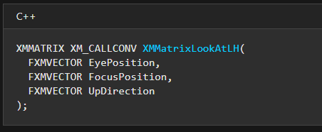
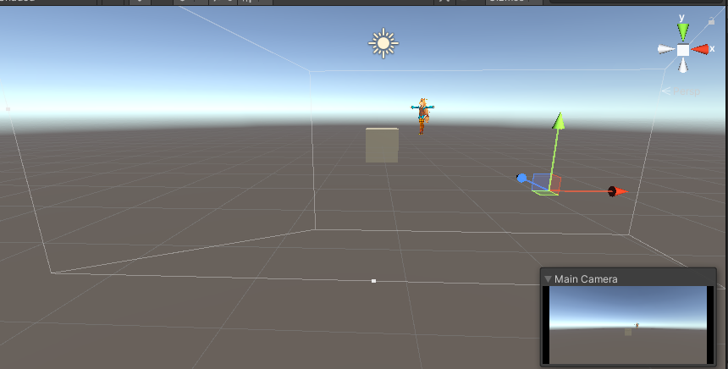
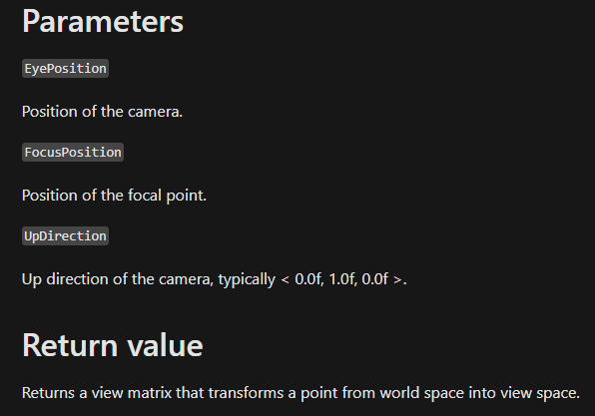


$$\left[\begin{matrix}{Right}_{x} & {Up}_{x} & {Look}_{x} & 0 \\ {Right}_{y} & {Up}_{y} & {Look}_{y} & 0 \\ {Right}_{z} & {Up}_{z} & {Look}_{z} & 0 \\ −\vec{C}⋅\vec{Right} & −\vec{C}⋅\vec{Up} & −\vec{C}⋅\vec{Look} & 1\end{matrix}\right]$$

